Slide 1

Performance of a T-SQL query
The mystery, the investigation and the root cause!
Cláudio Silva – 2026-05-22

Slide 2

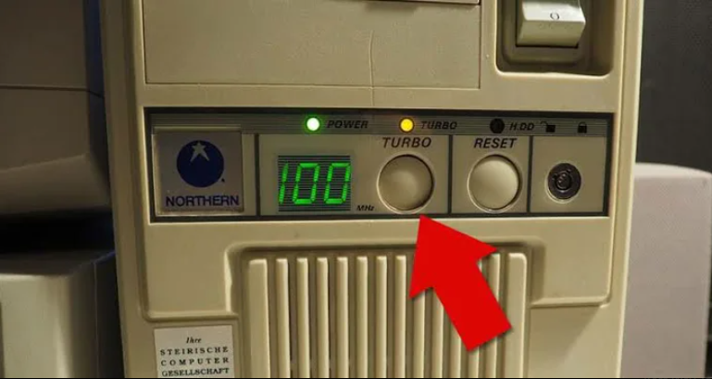
The solution to the problem!
Image source: Do you wish Turbo and Reset button would come back? - Water Cooler - Spiceworks Community
Notes:
Normally I keep the suspense until the very end, but this time I decided to go differently and I will tell you right away what we have done…
We had to push the button! And I mean, literally the “turbo button”
I’m joking :D

Slide 3

Agenda
The problem - the slow query
The investigation
The realisation
The way we make sure will won’t forget to check it again
Notes:
Quick agenda for today:

Slide 4

Goal
Learn a lot of things in 50ish minutes that could take days in real life
Notes:
I mean, if you were dedicated to just this topic probably within one day you would be fine.
Trying to do that in the middle of the work happening (world won’t stop) is a different story :D

Slide 5

Story time
"Any similarity to reality is pure coincidence"
Said by no one ever

Slide 6
Story time
"Any similarity to reality is pure coincidence"

Slide 7
Story time
This was the reality

Slide 8






Who am I?
Cláudio Silva
(He / Him)
What do I do?
Performance Tuning
Automation
claudioessilva
Open-Source Contributor
  dbatools
  dbachecks
claudioessilva
claudioessilva.eu

Slide 9

Story time - Problem
“We see queries being, at least, 3 times slower!”
The Client
Notes:
They said as an example, a query took 3 minutes and now +9

Slide 10
Notes:
Let’s think about it for a second…
I don’t know what you think, but for me, 3 times more…is a lot!
Here, your thoughts can start popping up and trying to find the reason for it.
But we need some context!

Slide 11

Story time - Context
Client went to the cloud with this database
I didn’t know about this database before
Due to costs 💸 , "let's go back on premises"
Some queries are now (at least) 3x slower
Notes:
Context always helps!
“Please share the execution plan”
Cool SELECT bunch of columns (46) from Database.schema.object
Give me an example of the query

Slide 12

Story time – The Query
The T-SQL was a
  SELECT (46) <columns> FROM <Database>.<Schema>.<Object>
  BUT…what do you mean by <Object>?
    a VIEW calling sub-views
Complexity ⬆️
But sure, the client was ok with the +3 minutes run, but not with +9.
Difficult to analyze where time was being spent because it was spread
(and sub-sub-views)
Notes:
The query:
I asked, “Please share the execution plan”
Cool, just a SELECT bunch of columns (46) from Database.schema.object
Complexity a bit high… but hey, client was seeing the query slower and we could also run the fast one on the cloud version… FOCUS Cláudio!
Nothing screams “I’m the problem” – Time being spent “evenly”

Slide 13

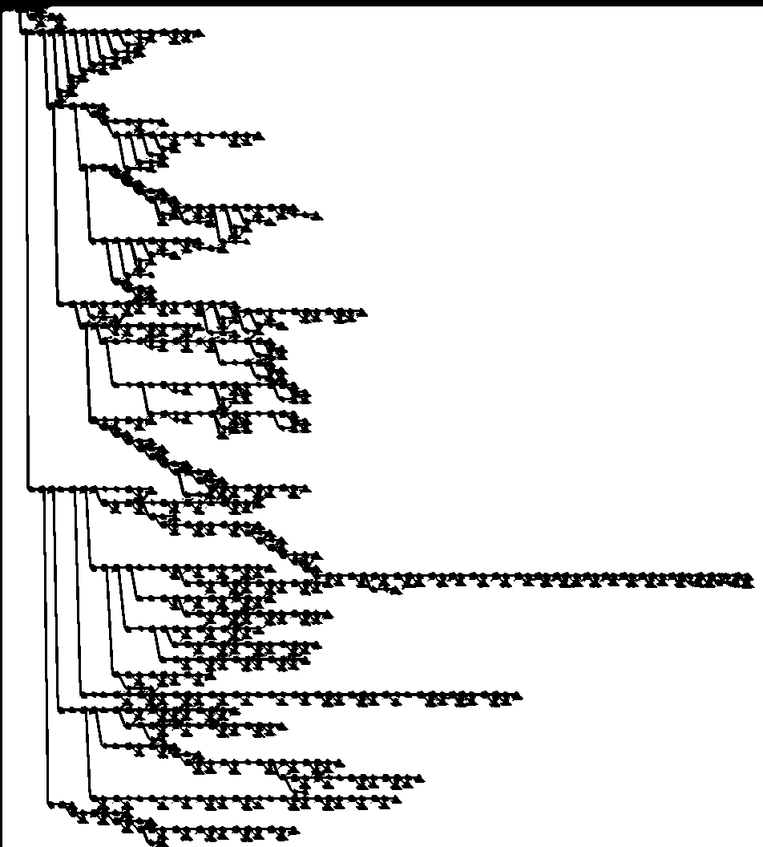
Story time – The Execution Plan
Notes:
On a 32” monitor the zoom to fit zommed out to ~7%

Slide 14
Story time – The Execution Plan
Notes:
On a 32” monitor the zoom to fit zommed out to ~7%

Slide 15
Story time – The Treasure Map
Notes:
So I decided to call it The Threasure MAP!
If we have a treasure map, we have an adventure, right?

Slide 16
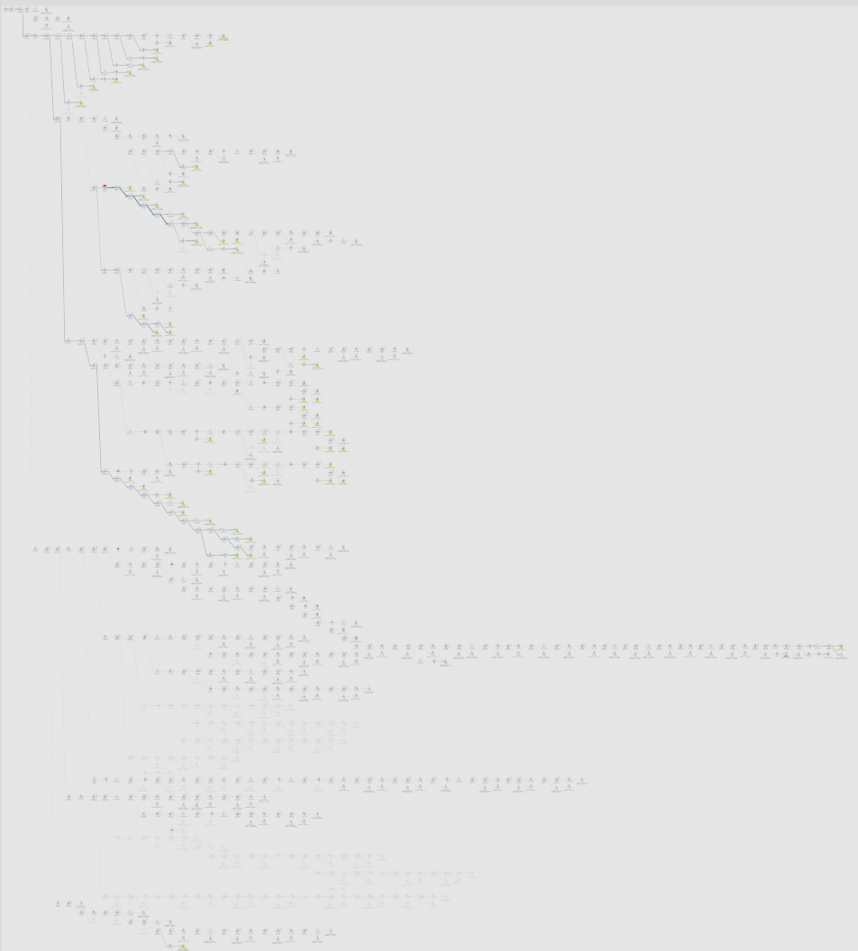
Notes:
Context always helps!
Give me an example of the query.

Slide 17
Notes:
Great Execution Plan art work!

Slide 18

Story time – Part 1 - Divide to conquer
Do I still have a slow query if I break it through?
I could see a simple join (between two tables) taking 2 seconds.
  But is that ok? It returns 438824 records.
  Is that slow? Fast?
“It works on my machine” 😏
  Generate the scripts with the schema and data.
  Ran it on an empty database on my laptop.
  It takes less than 900 ms (65% improvement)
Notes:
Let's say just a join between two tables!
For me it’s slow... but comparing with what?!
Let me check it on my laptop!
Problem solved! We replace the client’s VM with my laptop! :D
No, seriously, the slowness was on the Hash Match this is CPU time…why such big difference?

Slide 19
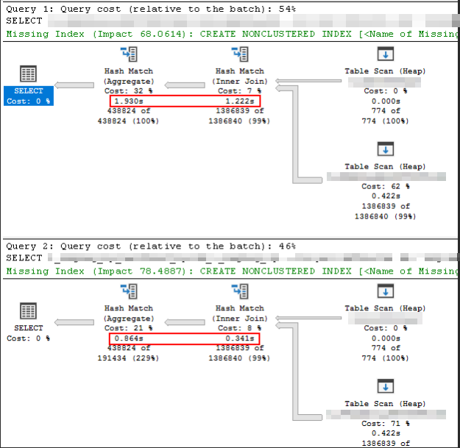
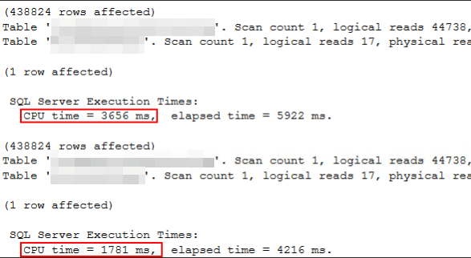
Story time – Part 1 - Divide to conquer
Do I still have a slow query if I break it through?
I could see a simple join (between two tables) taking 2 seconds.
  But is that ok? It returns 438824 records.
  Is that slow? Fast?
“It works on my machine” 😏
  Generate the scripts with the schema and data.
  Ran it on an empty database on my laptop.
  It takes less than 900 ms (65% improvement)
Notes:
Let's say just a join between two tables!
For me it’s slow... but comparing with what?!
Let me check it on my laptop!
Problem solved! We replace the client’s VM with my laptop! :D
No, seriously, the slowness was on the Hash Match this is CPU time…why such big difference?

Slide 20

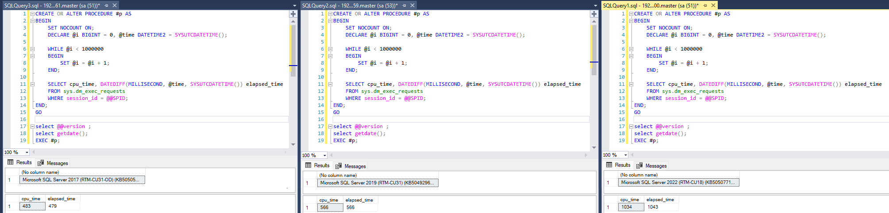
Story time – Part 2 - The adventure
SKU of Cloud vs VM on PREM
Asked if VM was different compared with older ones – NO
The best practices for SQL Server/VMWare were in place
They mentioned that something security-wise (TPM - Trusted Platform Module) was added to the VMWare templates.
  We spun a new VM without that setting so we could compare.
  Installed SQL Server, restored database, performance is still bad
  <Started thinking about my life choices>
Try to find how to measure CPU
  T-SQL with a while loop 1M times
Notes:
What have I checked?
1 – SKU from cloud and VM specs kind of matches (I even checked clock MHz speed)
2 – The best practices were in place
At somepoint I was checking how to measure CPU to understand if something was missing… Dirk tested on 3 diferente versions, here the results we saw ☺
I got the query from Erik Darling blog post called Quick SQL Server CPU Comparison Tests | Darling Data (https://erikdarling.com/quick-sql-server-cpu-comparison-tests/)
He explains how once he saw two identical servers with a big performance difference CPU wise. In the end it was a monitoring tool that were slowing things down!

Slide 21
Story time – Part 2 - The adventure

Slide 22
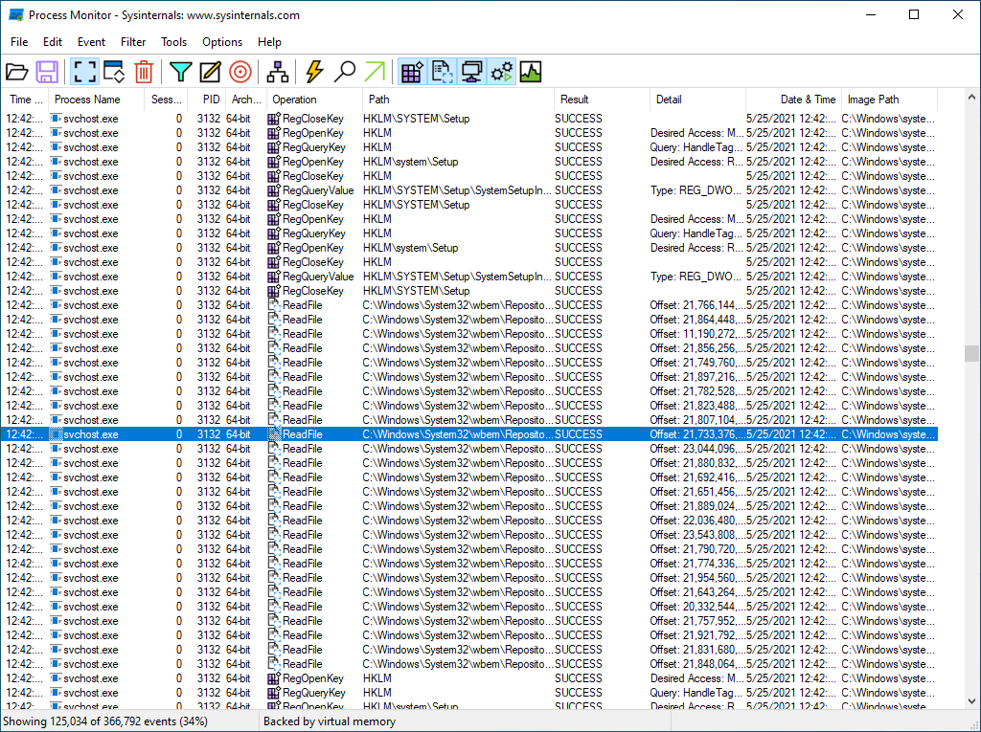
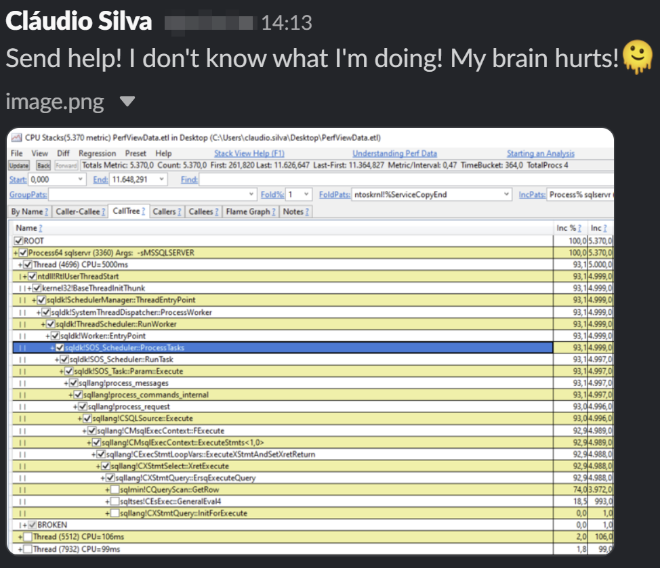
Story time – Part 2 - The adventure
I wanted something like Process Monitor, but for CPU, where is the CPU being wasted?
I found the CPU STACKS (PerfView) tool
Notes:
Process Monitor is great for checking what a process is touching on.
As an example I have used it before to understand why some agent job running SSIS packages were not able to access some folders. Ended up being lack of permissions but the error was completely different!
That was done using PerfView (CPU STACKS)!
Of course, I was with HIGH hopes I would find something… not really… back to square 0

Slide 23
Story time – Part 2 - The adventure
I wanted something like Process Monitor, but for CPU, where is the CPU being wasted?
I found the CPU STACKS (PerfView) tool
Notes:
If we have a treasure map, we have an adventure, right?
1 – SKU from cloud and VM specs kind of matches (I even checked clock MHz speed)
2 – The best practices were in place

Slide 24
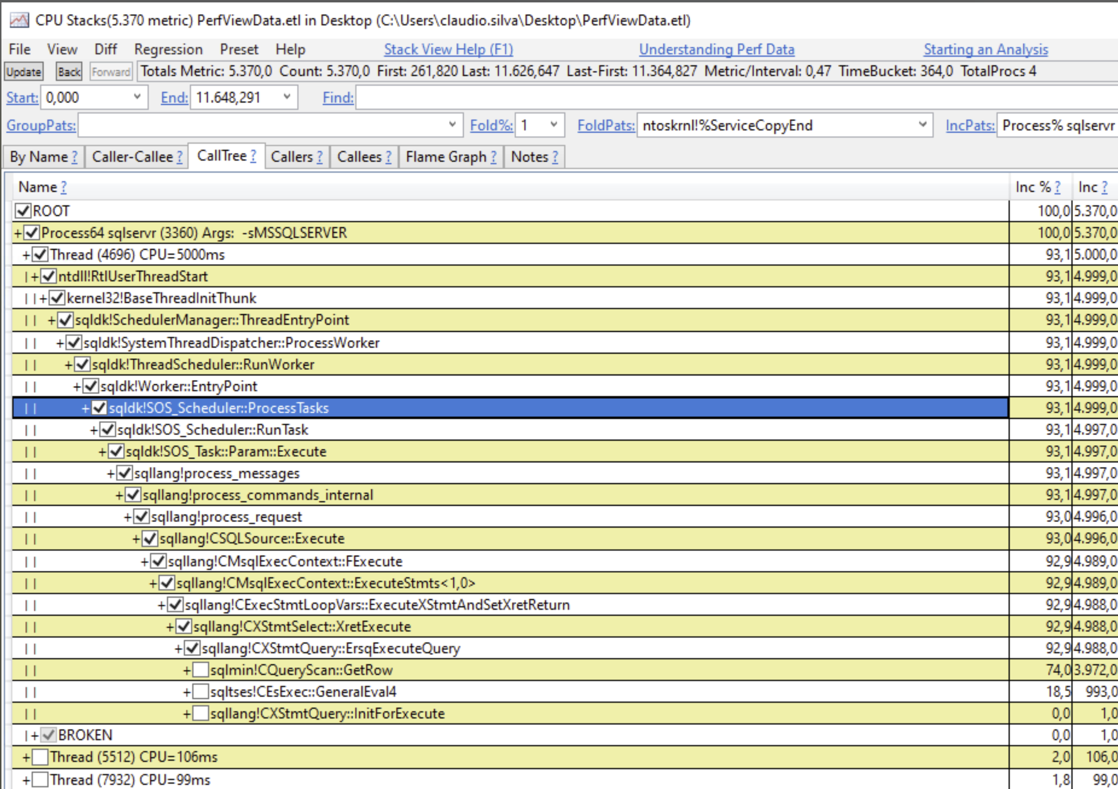
Story time – Part 2 - The adventure
I wanted something like Process Monitor, but for CPU, where is the CPU being wasted?
I found the CPU STACKS (PerfView) tool
Notes:
I saw this on a blog post from Erik Darling where he gave an example how this tool helped him once to get to the root cause of
Alternatives To Debugging SQL Server: PerfView | Darling Data (https://erikdarling.com/alternatives-to-debugging-sql-server/)

Slide 25

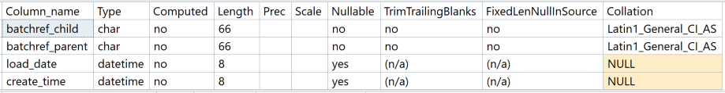
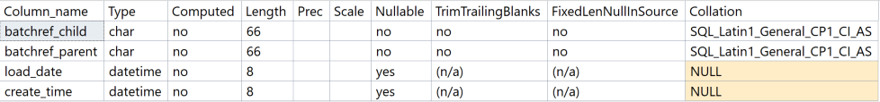
Story time – Found the treasure!
Table schema - Slow
Table schema - Fast
Notes:
AH-HA! Moment!
I restored the database and also ran the script generated before. I could see the slow and fast side by side.
I step back, and thought… let me compare these tables
And then I remember reading an blog post (from Eitan Blumin) about performance of collations
Very important!!!!
Because, by default, a script of the table from the SSMS doesn’t bring the current collation, this was faster to find.
Imagine if I did the right thing and scripted, including the collation… it would take longer to pinpoint the problem

Slide 26
DEMO TIME

Slide 27

Story time – Performance difference
“…view is now 3:42min (first run) instead of the 13:26min!”
The Client
Notes:
After this explanation, the client first couldn’t believe but after doing their tests came back with
Do you have any question?

Slide 28

Reminders / Caveats
Collations do have a purpose! They dictate ordering and comparison rules!
When scripting objects, be aware of the default scripting options!
Don’t close your eyes and just change the column collation!
  Be aware of views/functions that may be using it. Example: Doing concatenations(!)
Notes:
1 – Collations do have a purpose! They dictate ordering and comparison rules!
2 - by default, COLLATION is not included (like indexes, compression settings, among others).
3 – Be aware that changing collation can bring other pains. Columns that concatenate with others? Different collations will fail.

Slide 29
Reminders / Caveats
When installing a new SQL Server instance, ask which collation should be used
  It can be hard to change it after having data.
Remember that you can have different collations on different levels
  Instance
  Database
  Column
How often do you see “COLLATE DATABASE_DEFAULT” being used?
Notes:
1 – Collations do have a purpose! They dictate ordering and comparison rules!
2 - by default, COLLATION is not included (like indexes, compression settings, among others).
3 – Be aware that changing collation can bring other pains. Columns that concatenate with others? Different collations will fail.

Slide 30

Don’t forget to check it
T-SQL Query Performance – Decision Tree
Go to my:
GitHub – ClaudioESSilva
Repository – TSQLPerformanceTuning
You will find the decision tree done with Mermaid
Notes:
https://github.com/ClaudioESSilva/TSQLPerformanceTuning/blob/main/Flowcharts/T-SQLQueryPerformanceTuning.md

Slide 31
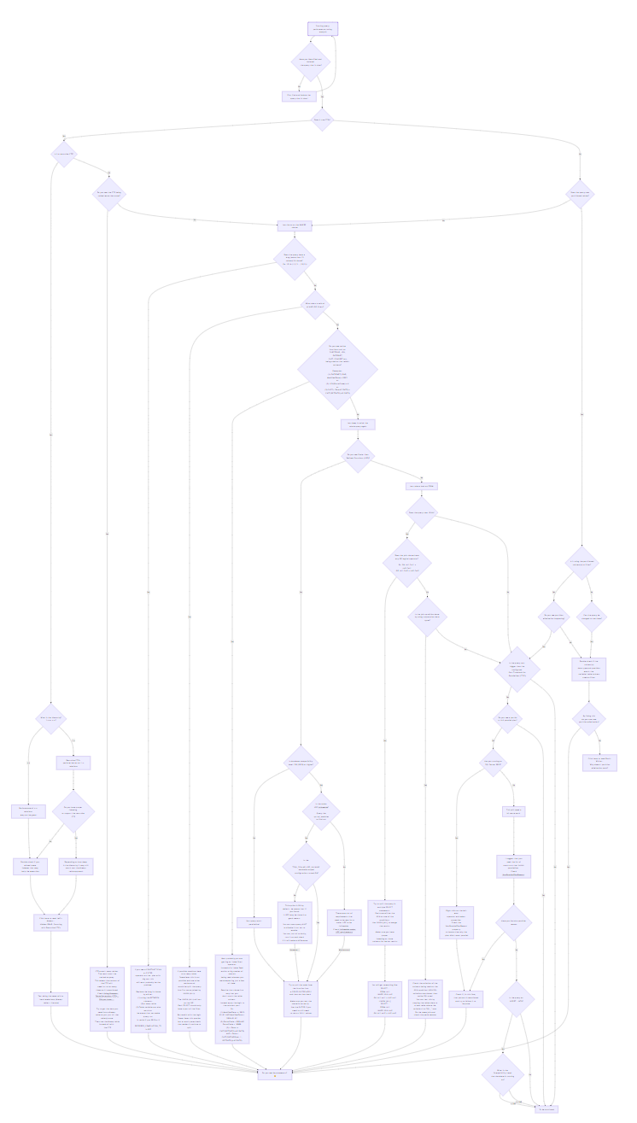
Notes:
https://github.com/ClaudioESSilva/TSQLPerformanceTuning/blob/main/Flowcharts/T-SQLQueryPerformanceTuning.md

Slide 32
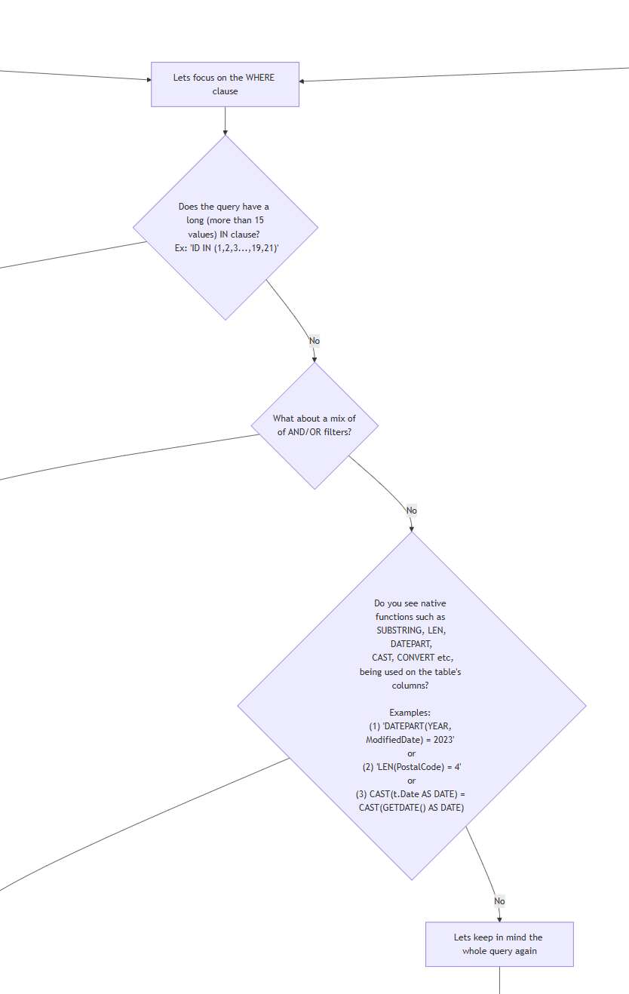
Notes:
https://github.com/ClaudioESSilva/TSQLPerformanceTuning/blob/main/Flowcharts/T-SQLQueryPerformanceTuning.md

Slide 33
Notes:
https://github.com/ClaudioESSilva/TSQLPerformanceTuning/blob/main/Flowcharts/T-SQLQueryPerformanceTuning.md

Slide 34
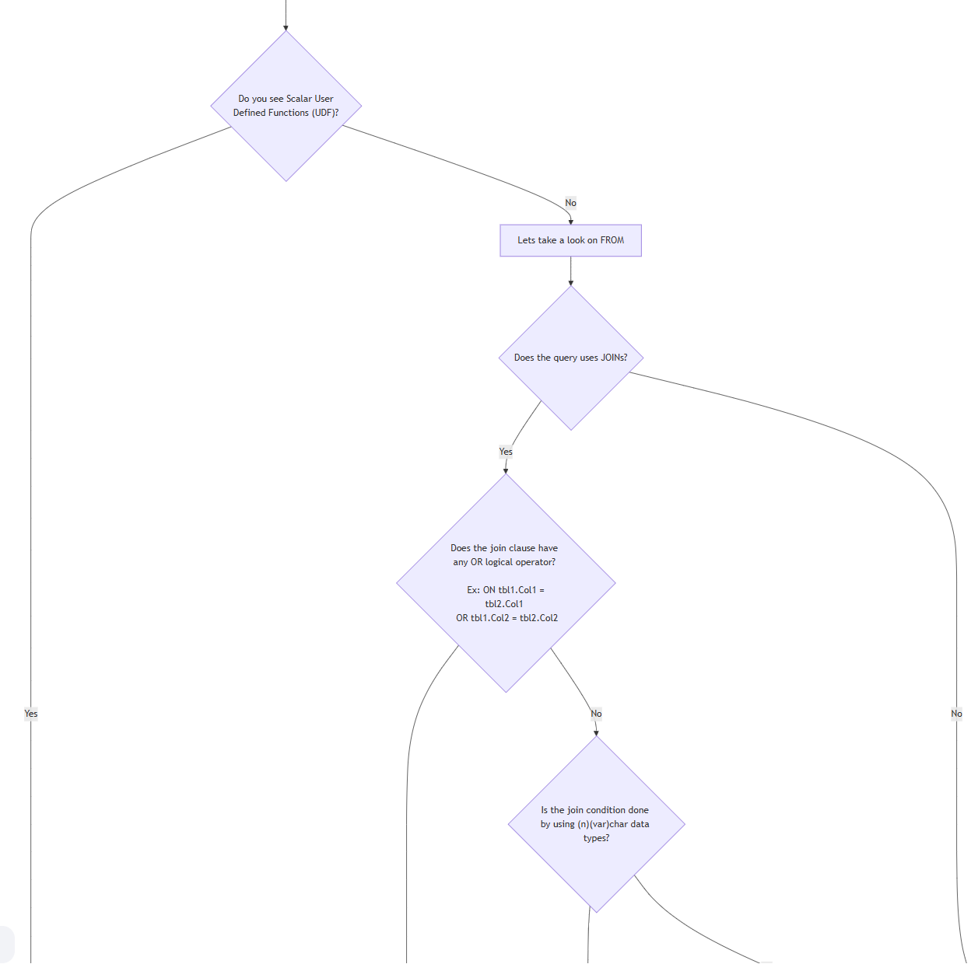
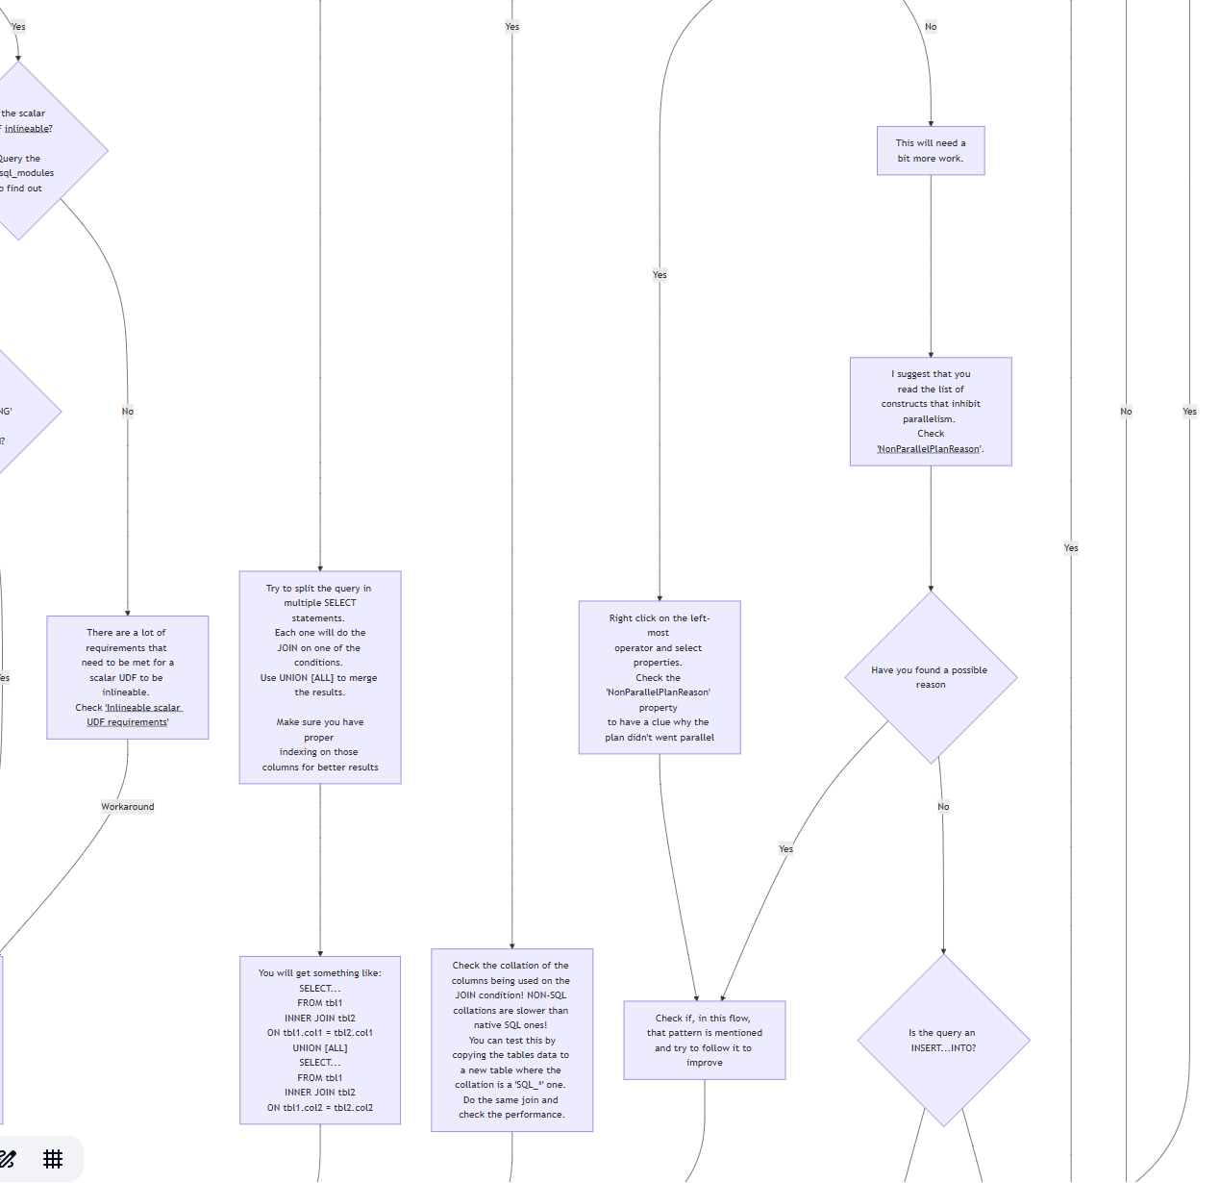
Notes:
https://github.com/ClaudioESSilva/TSQLPerformanceTuning/blob/main/Flowcharts/T-SQLQueryPerformanceTuning.md

Slide 35
Notes:
https://github.com/ClaudioESSilva/TSQLPerformanceTuning/blob/main/Flowcharts/T-SQLQueryPerformanceTuning.md

Slide 36
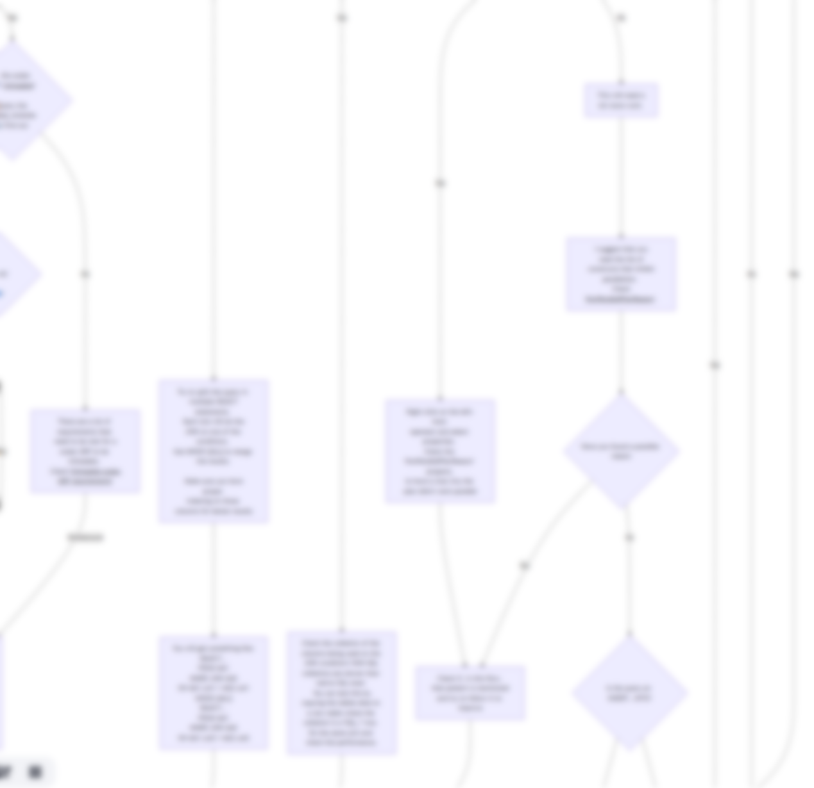
Notes:
https://github.com/ClaudioESSilva/TSQLPerformanceTuning/blob/main/Flowcharts/T-SQLQueryPerformanceTuning.md

Slide 37
Notes:
https://github.com/ClaudioESSilva/TSQLPerformanceTuning/blob/main/Flowcharts/T-SQLQueryPerformanceTuning.md

Slide 38
Decision tree can give you a hint
Notes:
https://github.com/ClaudioESSilva/TSQLPerformanceTuning/blob/main/Flowcharts/T-SQLQueryPerformanceTuning.md
Is this the solution for everything? NO! But will help a bit ☺

Slide 39
Feeling lazy?
Too much manual work?
Use AI (with this trick)
Notes:
Reading this decision tree -> https://github.com/ClaudioESSilva/TSQLPerformanceTuning/blob/main/Flowcharts/T-SQLQueryPerformanceTuning.md <- can you find a reason for the same query being 3x slower when running on two different environments? It's a simple SELECT with 1 join by a char columns.
I used Claude. Didn’t have good results with ChatGPT

Slide 40

Resources
Microsoft KB
Comparing SQL collations to Windows collations
Erik Darling Blog Posts:
Quick SQL Server CPU Comparison Tests | Darling Data
Alternatives To Debugging SQL Server: PerfView | Darling Data
Eitan Blumin
The Curious Case of... Collations and Performance in SQL Server - Eitan Blumin's blog
Sysinternals
Process Monitor - Sysinternals | Microsoft Learn
PerfView (CPU STACKS)
microsoft/perfview: PerfView is a CPU and memory performance-analysis tool
Cláudio’s Decision Tree for T-SQL Performance Tuning
TSQLPerformanceTuning
Notes:
https://github.com/ClaudioESSilva/TSQLPerformanceTuning/blob/main/Flowcharts/T-SQLQueryPerformanceTuning.md
Is this the solution for everything? NO! But will help a bit ☺

Slide 41

Session Feedback

